Slide 1
1. Connect
2. Git
3. Docker
4. Kubernetes
5. CI/CD
6. Misc

Slide 2
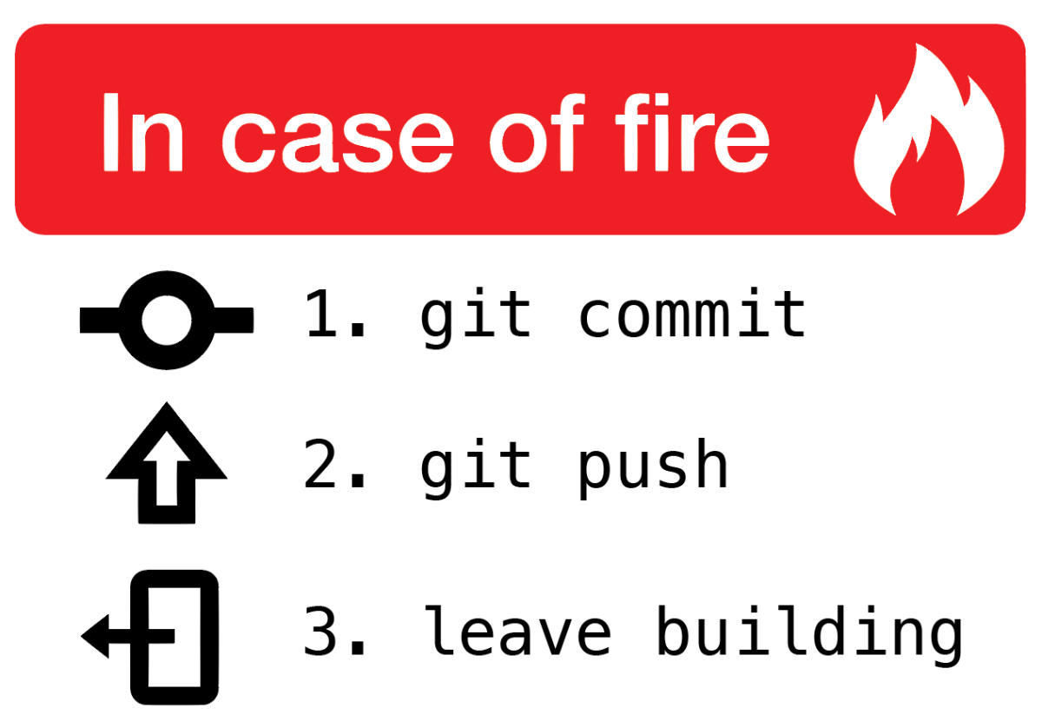

Slide 3

Git is a free and open source distributed version control system designed to handle everything from small to very large projects with speed and efficiency

Slide 4
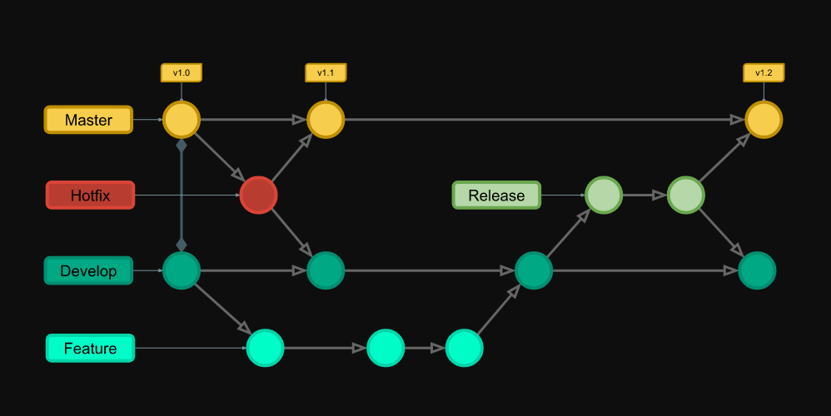
Git flow

Slide 5

Basic Concepts
1. Repository The place where you code is storred. Can be local and/or remote 2. Branch Is a movable pointer to one of the commits. 3. Commit Snapshot of the project with the newly added changes 4. Clone Local copy of the repository. 5. Fork Copy of the main repository, under your own name.

Slide 6




Git solutions with added tools/services/functions etc.

Slide 7

Git is easy,
but can be really hard

Slide 8
1. Connect
2. Git
3. Docker
4. Kubernetes
5. CI/CD
6. Misc

